Slide 1

PnPjs Fluent Queries

Slide 2

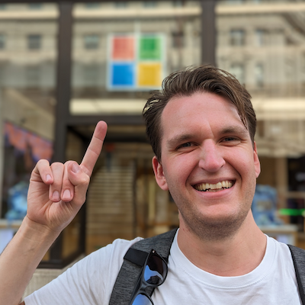
Dan Toft
Evobis ApS
M365 Development & Microsoft Graph MVP
Nerd at large

Slide 3
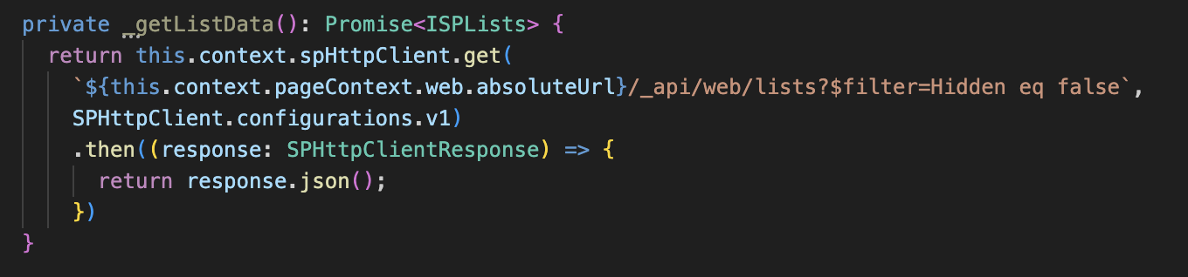
Orange is the new bad

Slide 4
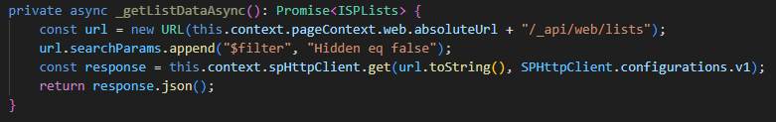

Slide 5
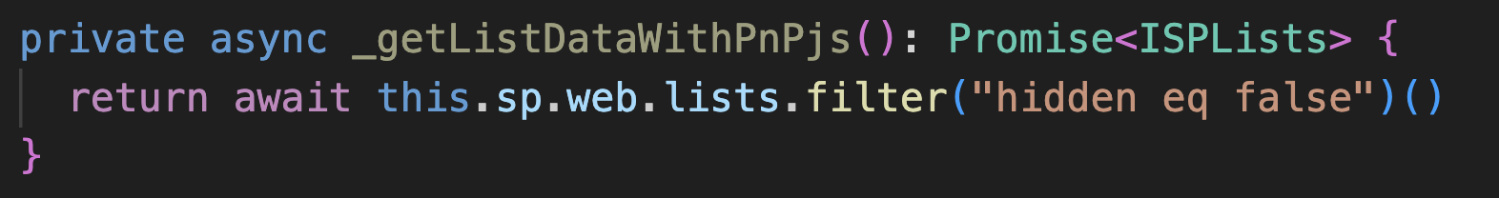
npm install @pnp/sp @pnp/graph --save

Slide 6
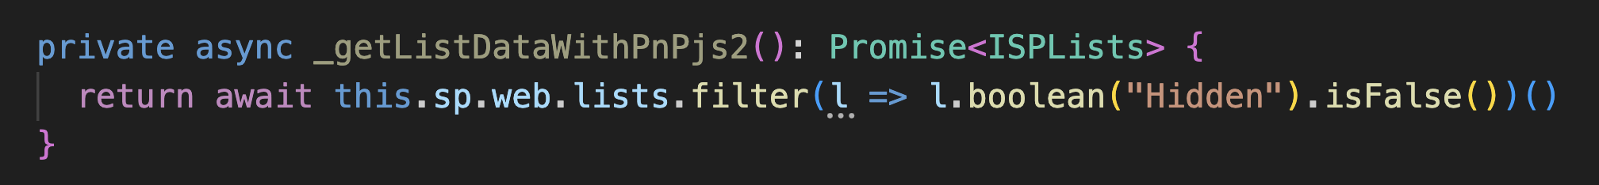

Slide 7
Demo time

Slide 8
Dan Toft
Evobis ApS
🐦 @Dan-Toft.dk
📝 Dan-Toft.dk
See you @ ESPC in a few days

